Slide 1
MONOPOLY
Dr. Napinder Kaur
Assistant Professor

Slide 2
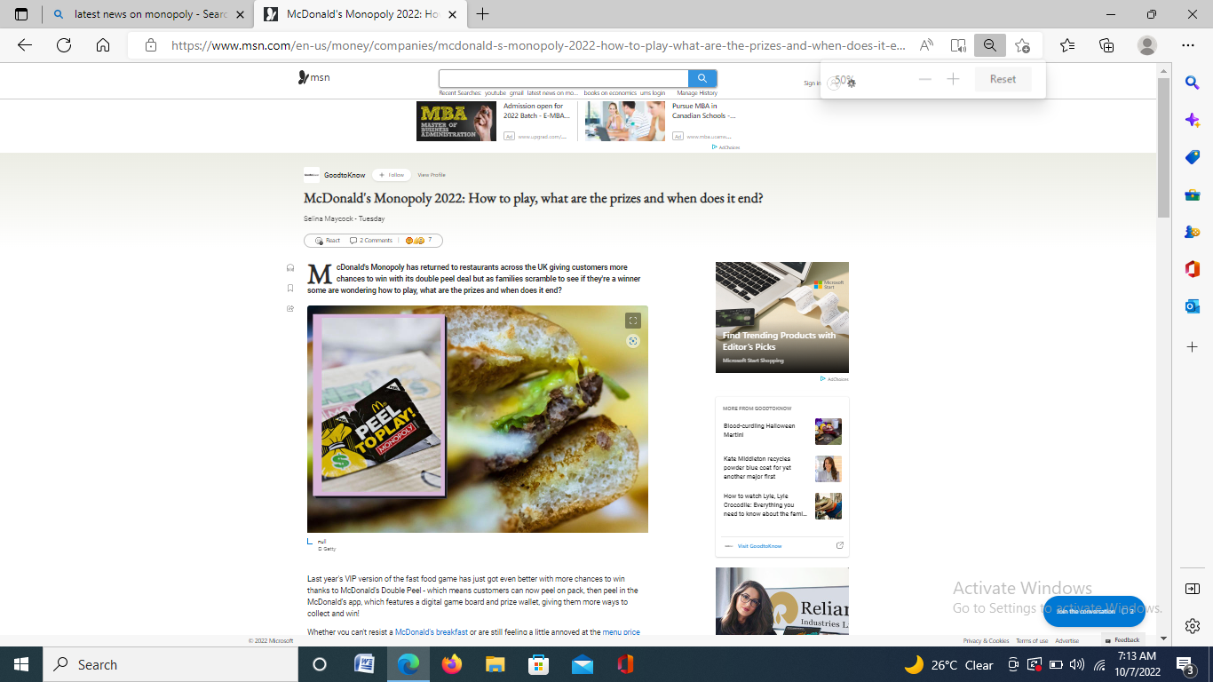
WHAT’S IN THE NEWS?

Slide 3
LEARNING OUTCOMES
After the lecture, you will be able to
Examine the nature and different forms of a monopoly market.
Explore the vistas of emergence of monopoly power,

Slide 4
MONOPOLY
FEATURES:
Single seller
Single product
No difference between firm and industry
Independent decision making
Restricted entry

Slide 5
MONOPOLY
Monopoly: the earnings of many in the hands of one: EUGENE DEBS

Slide 6
REASONS FOR MONOPOLY
Restricted by law
Control over key raw materials
Specialised know how
Economies of scale
Small market size

Slide 7
…..CONTD.
DEMAND AND MARGINAL REVEUNE CURVES FOR A MONOPOLY FIRM

Slide 8
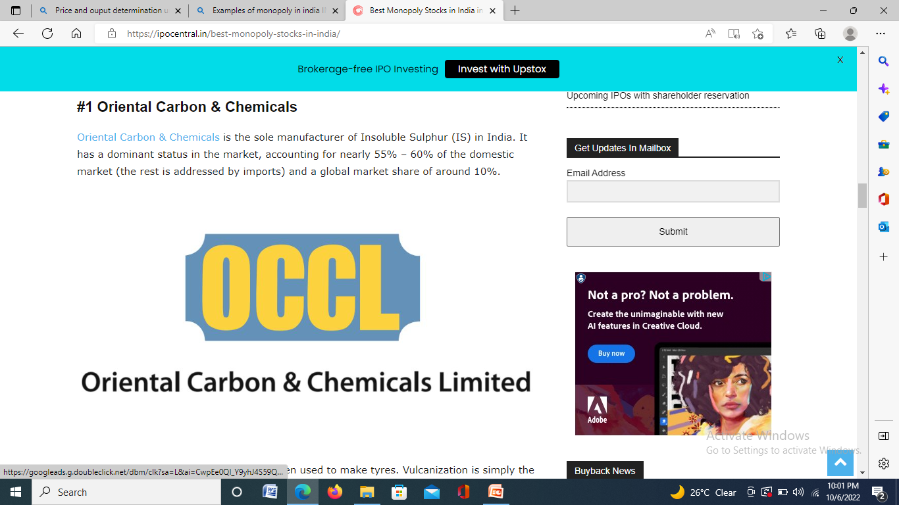
EXAMPLE

Slide 9
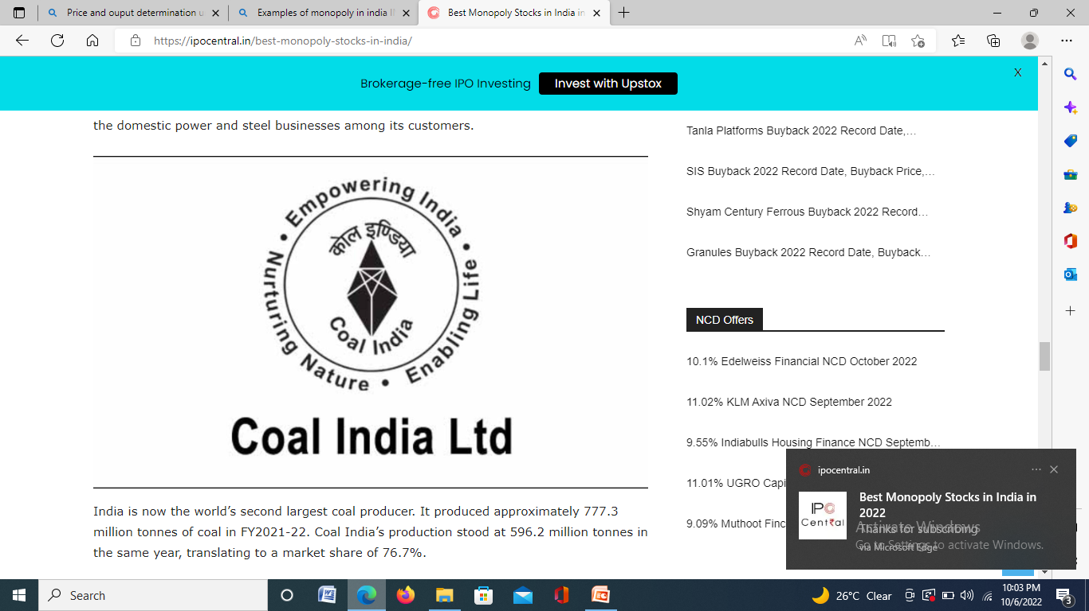
EXAMPLE

Slide 10
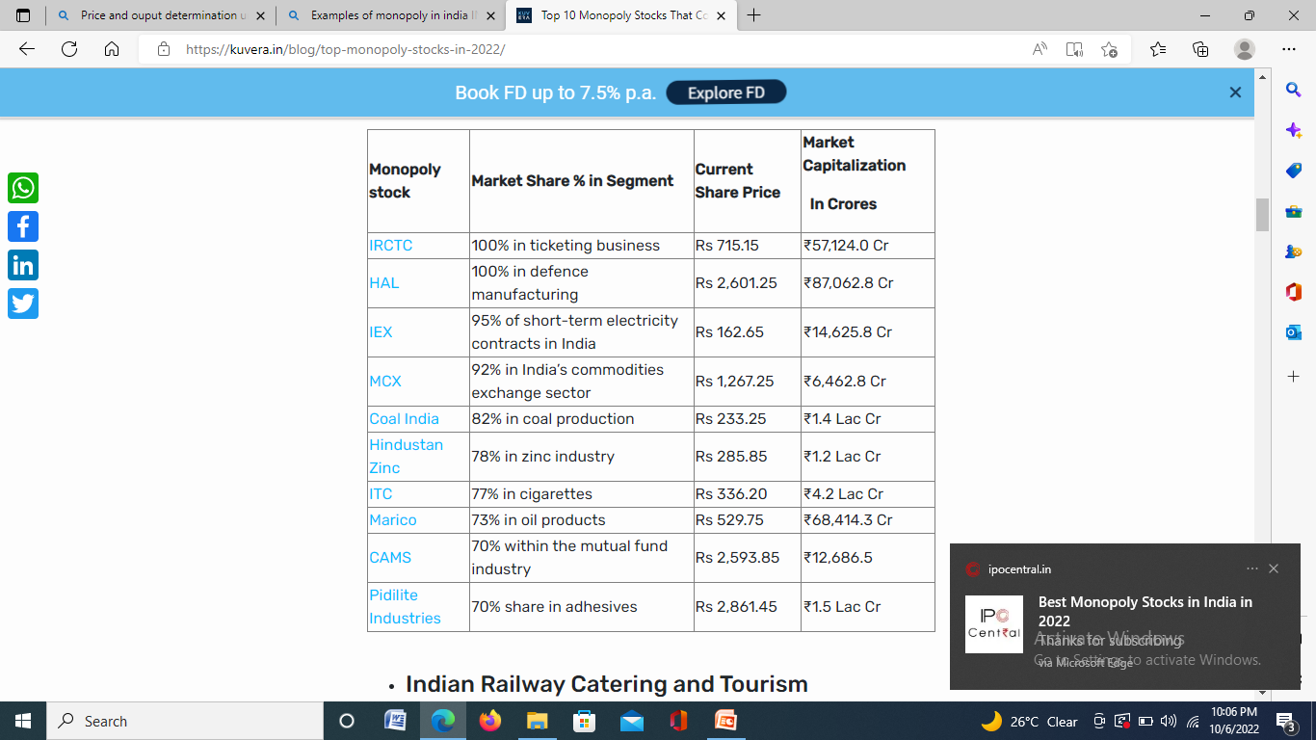
MONOPOLY STOCKS

Slide 11
PRICE AND OUTPUT DETERMINATION
Short run analysis
Long run analysis

Slide 12
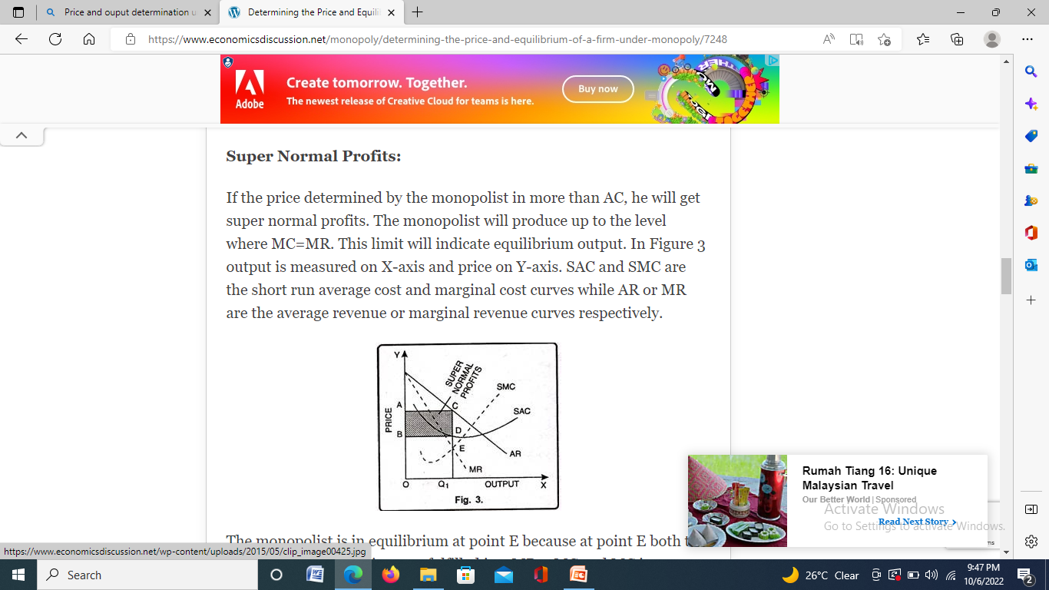
SUPER NORMAL PROFITS

Slide 13
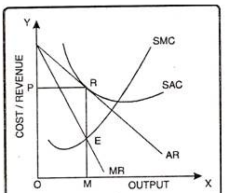
NORMAL PROFITS

Slide 14
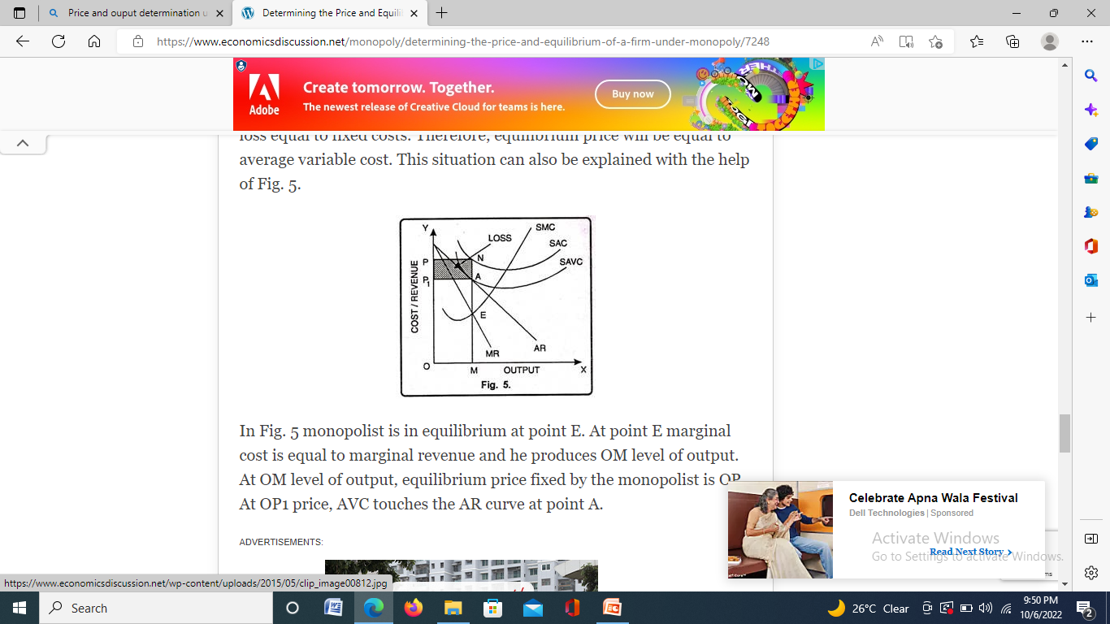
LOSS

Slide 15
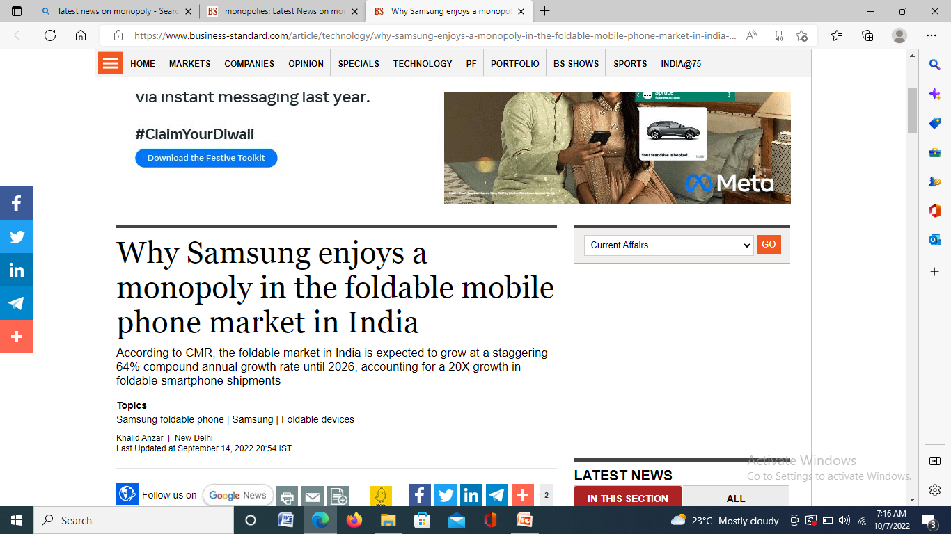
CASE ANALYSIS

Slide 16
LONG RUN ANALYSIS
SUPER NORMAL PROFITS

